Slide 1
EI Visual Test Automation
For RIA applications
16-Sep-2016
EI Product Team

Slide 2
The Problem
The Solution
The Demo
The Comparison
Where We Are
What Next
Questions

Slide 3
The Problem

Slide 4
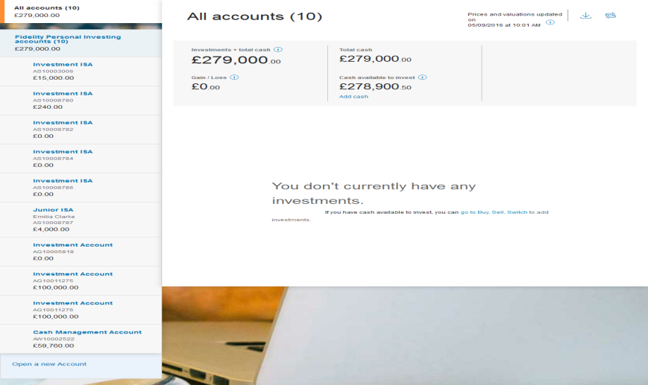
The Problem
(Case 1) : Here’s a snapshot of our Account Summary Page (Pre-Deployment)

Slide 5
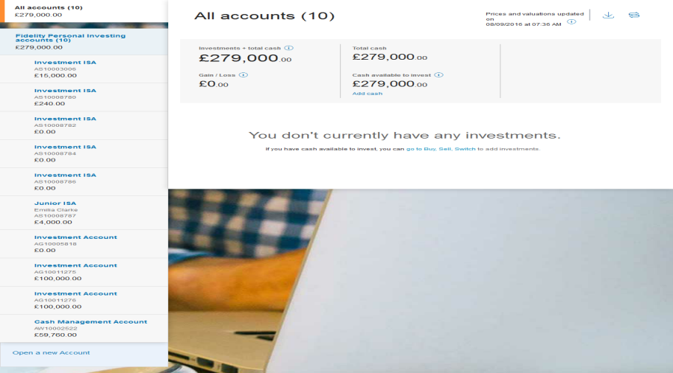
The Problem
(Case 1) : A few iterations later, another snapshot of our Account Summary Page (Post-Deployment)

Slide 6


The Problem
(Case 1) : And here they are, side by side. How are they different?

Slide 7
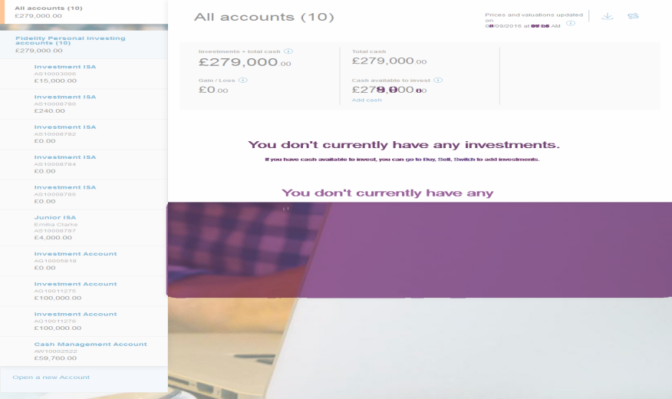
The Problem
(Case 1) : Well, here’s the difference (Visual Changes Post Deployment)

Slide 8
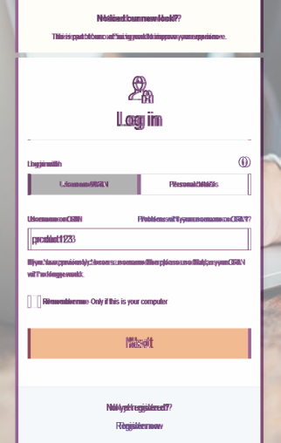

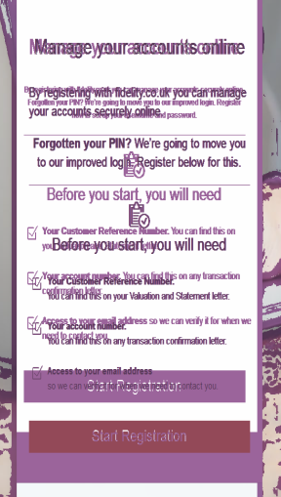
Other Examples

Slide 9
The Problem
Considering just EI,
7 live applications, 2 applications on the way
17 view ports
Average 2 happy scenarios per application from login to logout.
Average 5 mins per scenario (Login is quick, OTD is long)
We are looking at approx. 23 hours of manual testing effort per deployment just to validate the UI.
Even then there’s no guarantee that we’ll be able to identify every UI mismatch.

Slide 10
The Solution

Slide 11
The Solution
… so we started
Automate it !!
Compare the UI against a baseline
Generate a nice report
take pictures at logical steps of the journey
run journeys end to end using script
Save Time and effort
emulate/simulate different browsers and device behaviors.

Slide 12
The solution
A JavaScript based tool,
that runs on nodeJS-Grunt platform,
built with open sourced and free tools,
that runs journeys end to end after every deployment,
that simulates different devices and browsers,
that takes snapshots of different regions of the page
that then, compares the snapshots against a standard set of images,
generates a report of the mismatch.

Slide 13
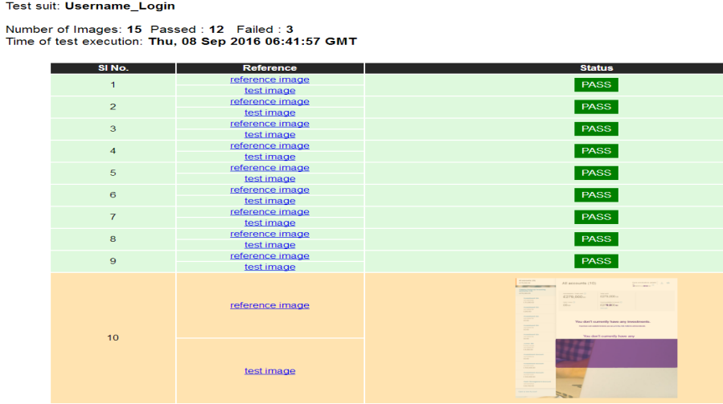
The Solution
The generated report

Slide 14
The Demo

Slide 15
The Comparison
Between Selenium, BackstopJS, and our Visual Regression tool
Selenium
Backstop
Our Automation Tool
Integrates with saucelabs to emulate real device and browsers
Can run user journeys end to end, visual and functional testing
Difficulty level – Medium
Can take snapshots
Cannot compare images
Stable Solution
Simulates browsers and devices in phantomJS
Cannot run journeys end to end, visual testing only
Difficulty level – Low
Can take snapshots
Can compare images
Open Sourced, and has bugs
Simulates browsers and devices in phantomJS
Can run user journeys end to end, visual and functional testing
Difficulty level – Low.
Can take snapshots
Can compare images
So far, we are getting what we want, and we are improving every day..

Slide 16
Where we are ?
VRT HC has been successfully automated on SIT/UAT/EBF/PROD environment for below mentioned EI journeys :
CDB/Username Login for Migrated/Non-Migrated Clients.
Navigation to EI Pages
Registration Page
Personal Details Login Page
Mobile Verification
Account Summary
Add Cash
Withdraw Cash
Regular Saving Plan
Transaction History
Dealing
Dealing-Buy

Slide 17
What next
Integrating with CI, so that it runs after every deployment
Run multi-device configurations at a single go
Set it up on GIT and share across teams, set up a collaborative model.
VRT Implementation for Complete EI Journeys
HTML Report Browser Compatibility Issues fixing
Exploring PDF Reporting Mechanism which will enhance report portability and readability.

Slide 18
Thank you!!
…. ready for the questions

